Slide 1
БОЈЕ И ОБЛИЦИ

Slide 2

ПЛАВИ КРУГ

Slide 3

ЗЕЛЕНИ КВАДРАТ

Slide 4

ЖУТА ЗВЕЗДА

Slide 5

ПЛАВИ ПРАВОУГАОНИК

Slide 6

ЦРВЕНИ ТРОУГАО

Slide 7
СЛОВА

Slide 8

This Photo by Unknown Author is licensed under CC BY-SA

Slide 9
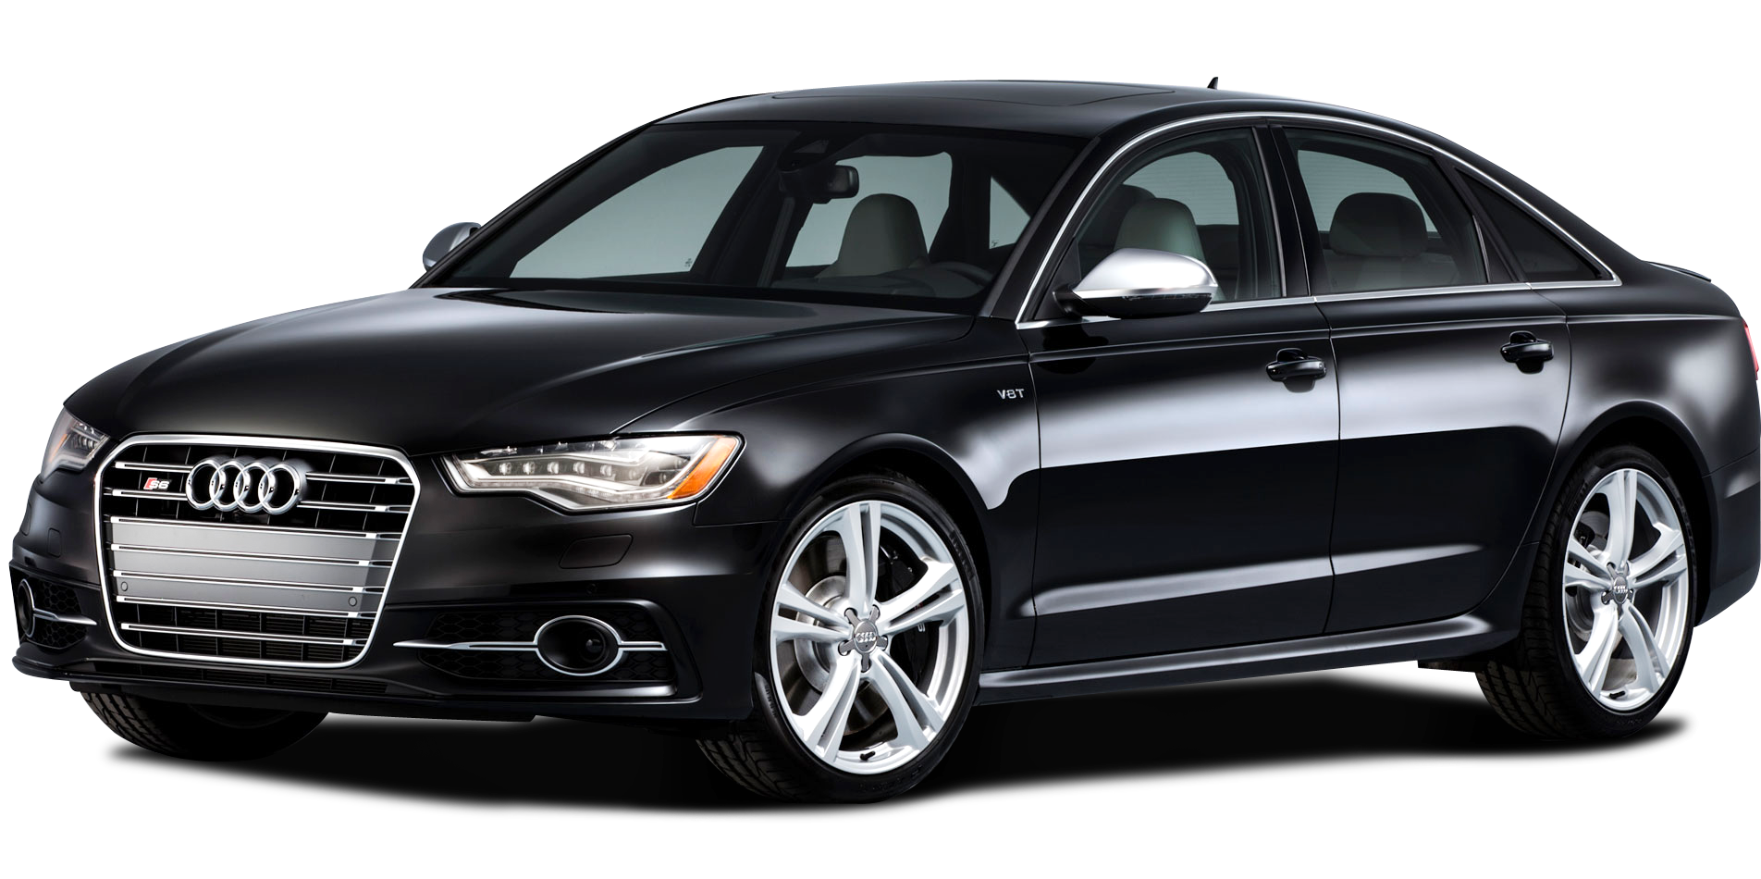
АУТО
This Photo by Unknown Author is licensed under CC BY-NC

Slide 10
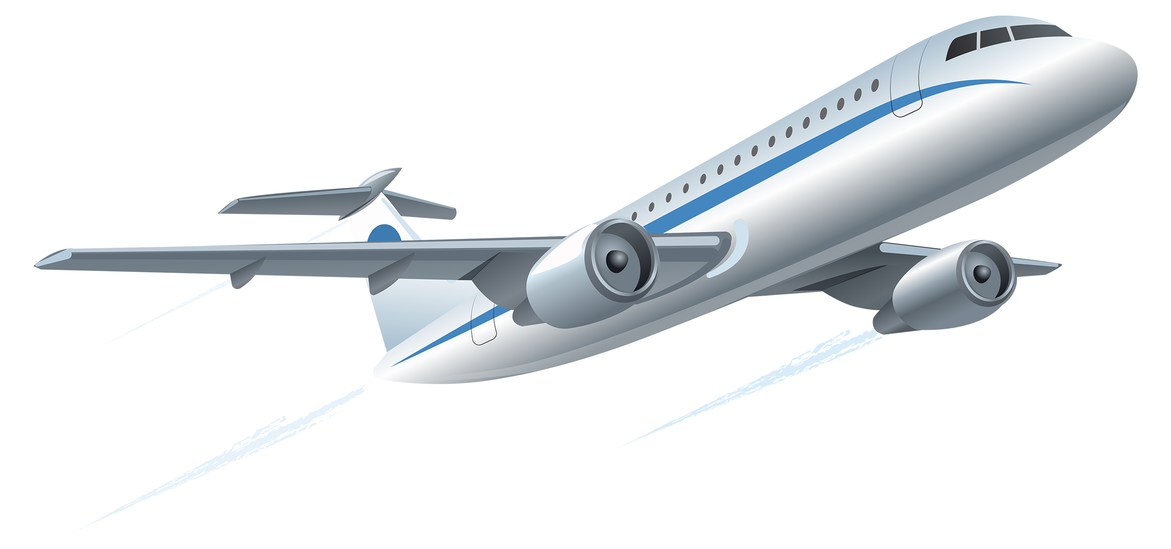
АВИОН
This Photo by Unknown Author is licensed under CC BY-NC

Slide 11


Slide 12
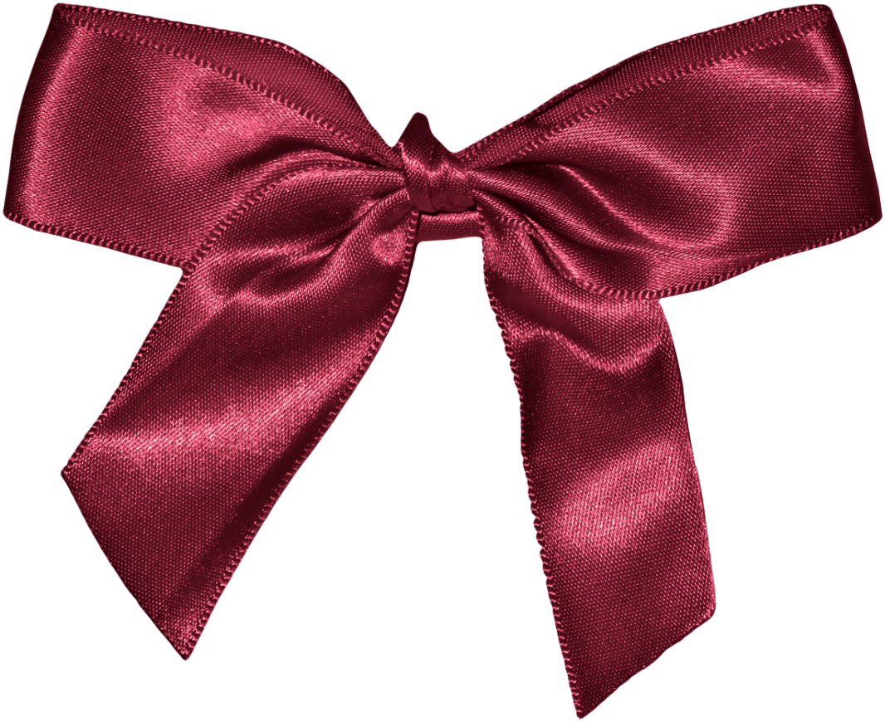
МАШНА

Slide 13
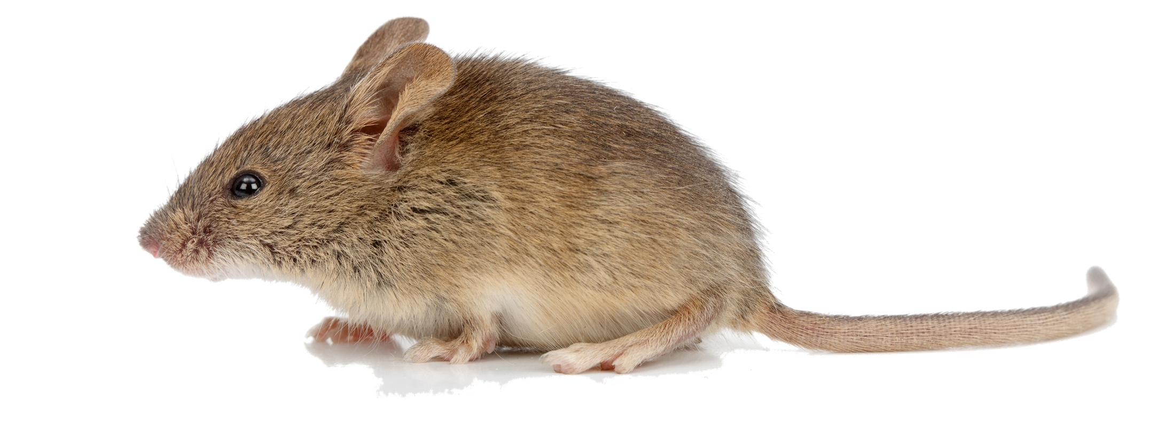
МИШ

Slide 14
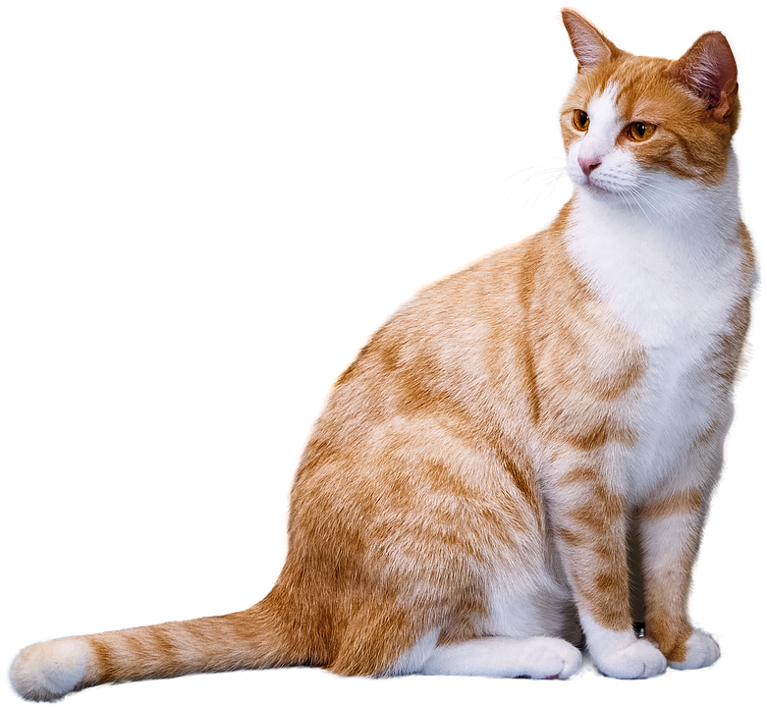
МАЧКА

Slide 15


Slide 16
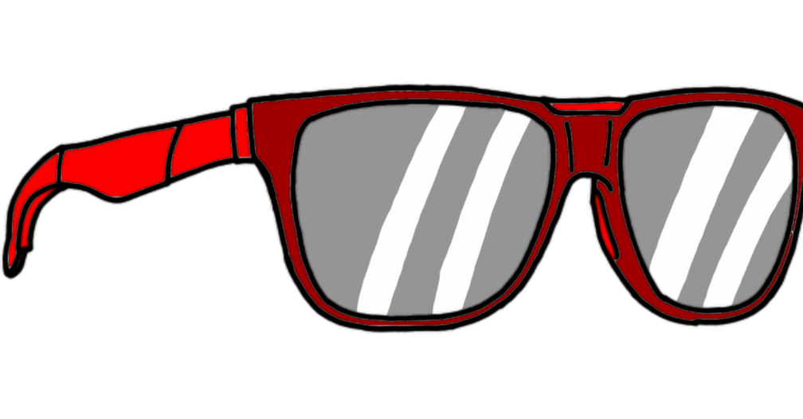
НАОЧАРЕ

Slide 17
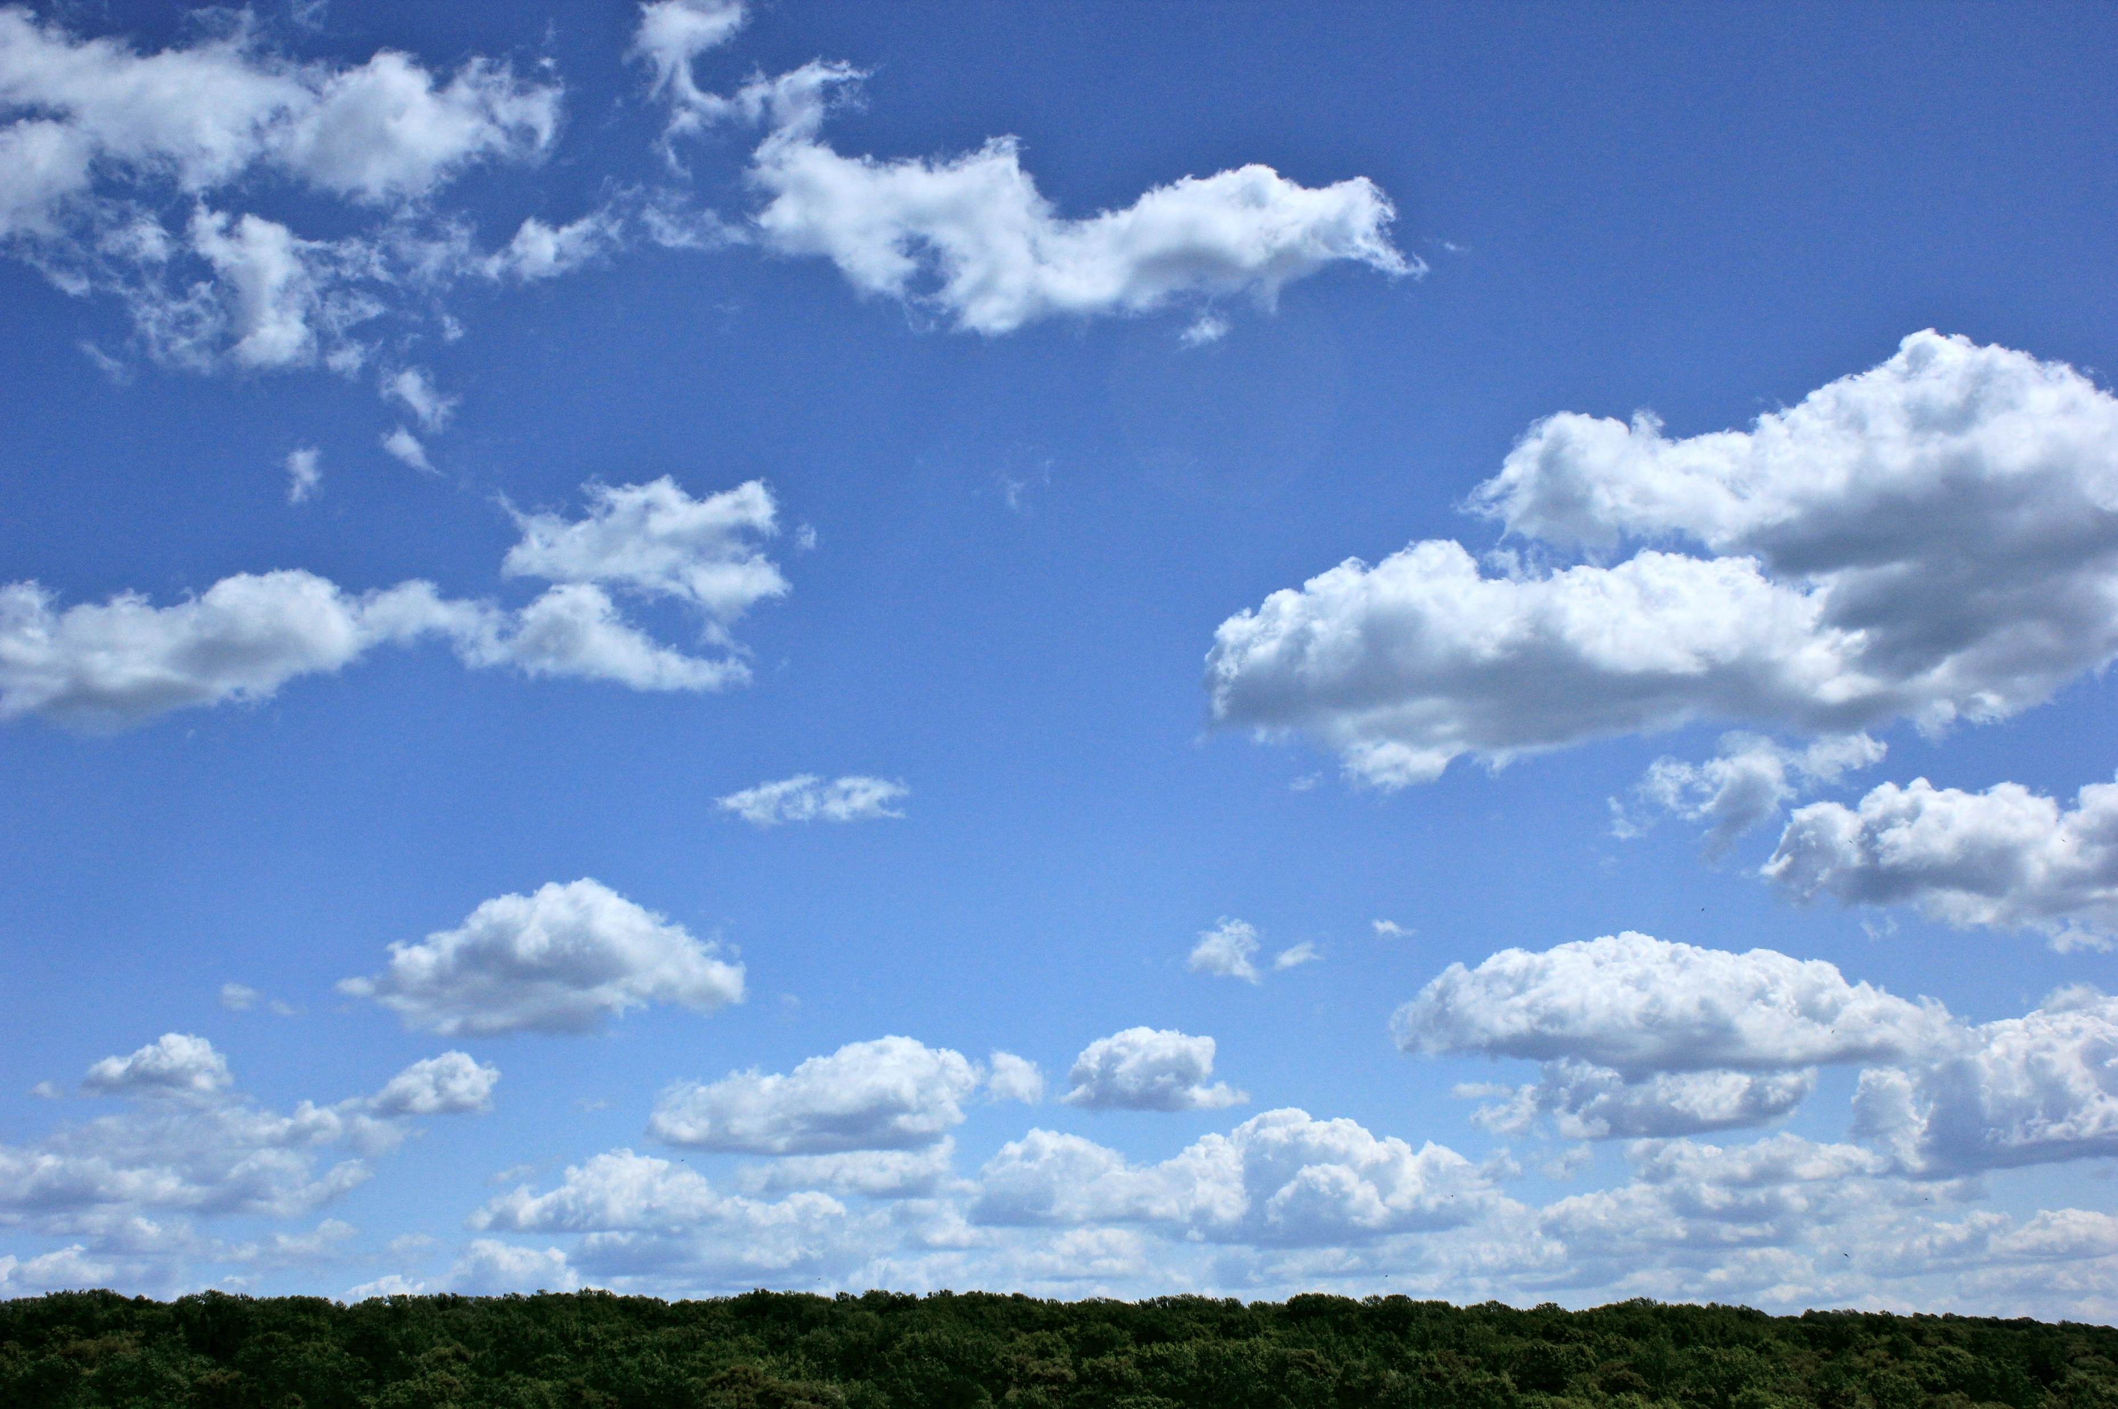
НЕБО
This Photo by Unknown Author is licensed under CC BY-SA

Slide 18
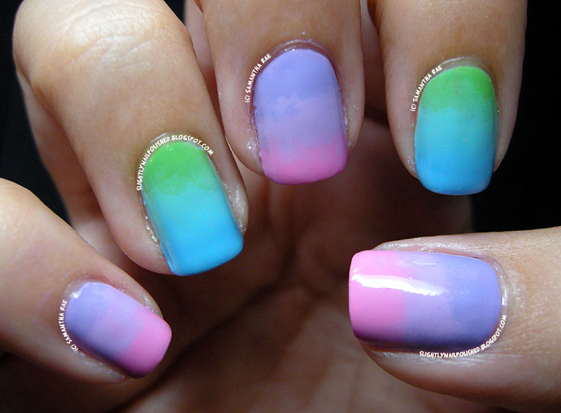
НОКТИ

Slide 19

This

Slide 20
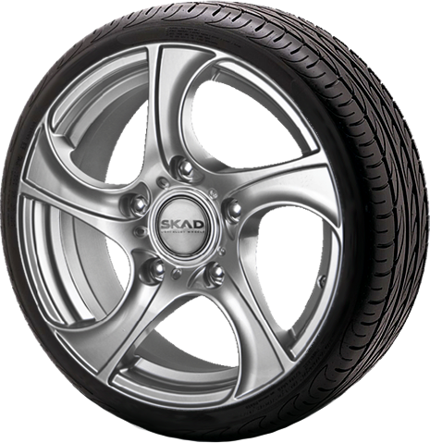
ТОЧАК
This Photo by Unknown Author is licensed under CC BY-NC

Slide 21
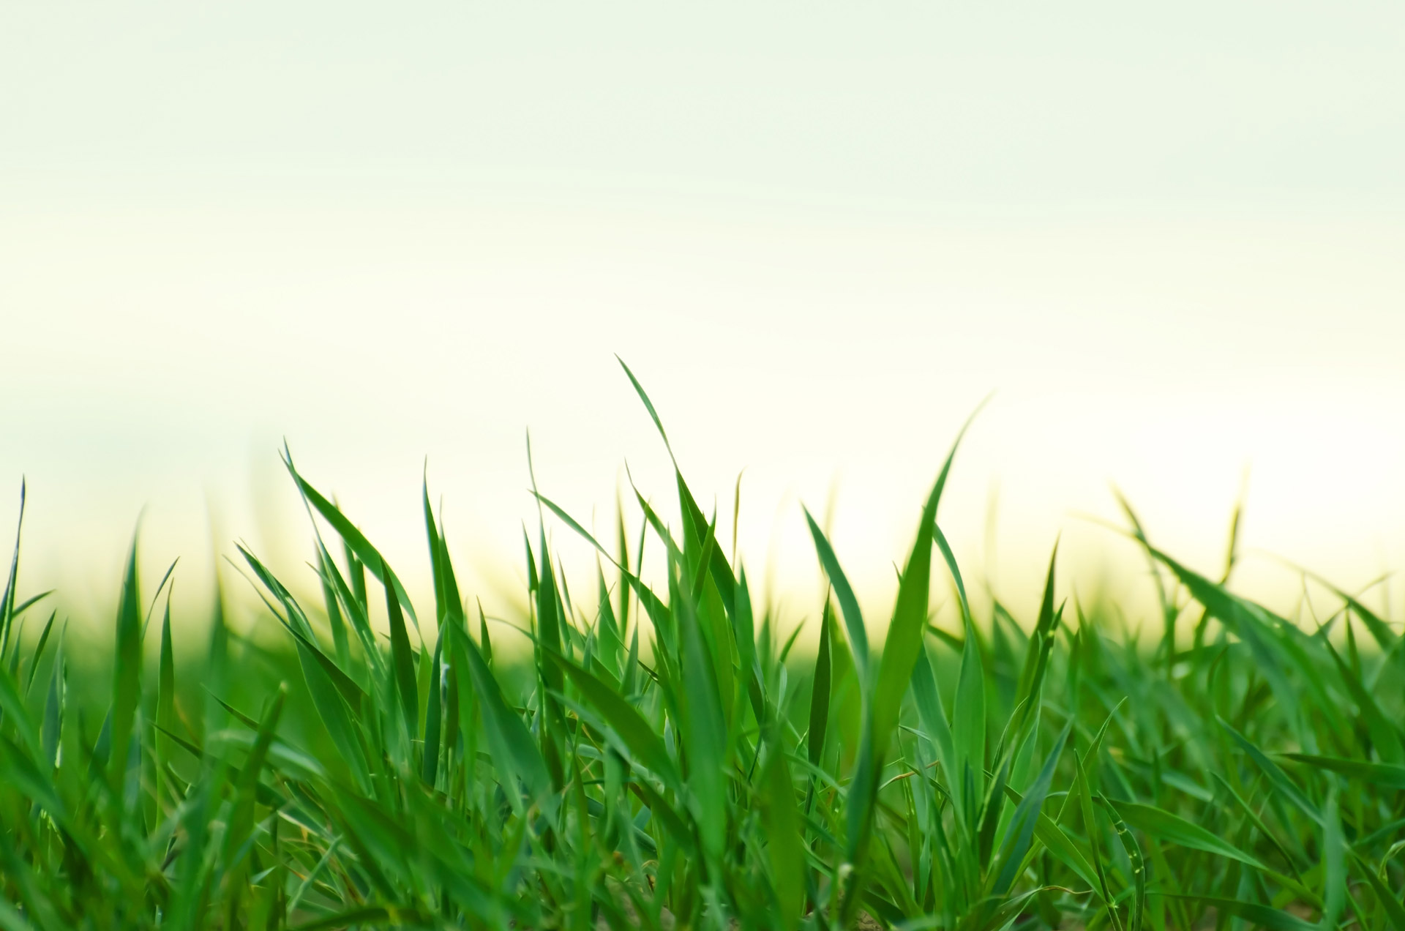
ТРАВА

Slide 22
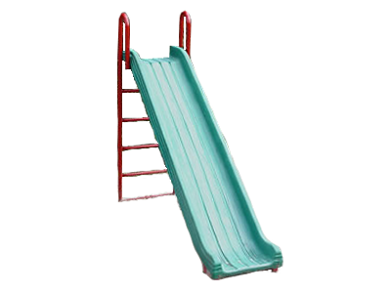
ТОБОГАН
This CC BY-SA-NC

Slide 23

БРАВО!!!

